Slide 1
Automatic Room Lighting System
Under the Guidence of:
K.V.Prasanth
(ECE-Department)
By
G.Pravesh (12003271)
N.Likitha
D.Maheswara reddy(12003317)
Y.Bharath Sai Ratna (11003124)

Slide 2
Abstract
The concept of “AUTOMATIC ROOM LIGHTING SYSTEM” is about controlling of room lights using 8051-Microcontroller. When a person enters into a room, lights located in that room will ON after some time again it is going to OFF.

Slide 3
Block Diagram
LCD Screen
Switch-1
Micro-
Controller
Switch-2
LED-1
LED-2

Slide 4
Flow Chart
Start
Button 1
Button 2
No
No
Yes
Yes
LCD print
“The person is in”
LCD print
“The person is OUT”
LED ON
LED OFF
Stop

Slide 5
Methodology
When we click switch-1 led will ON and display in the lcd screen as PERSON IS IN.
When we click switch-2 led will OFF and display in the lcd screen as PERSON IS OUT.
When both the switches are OFF it will display int the lcd screen as NO ONE IS ENTERING.

Slide 6
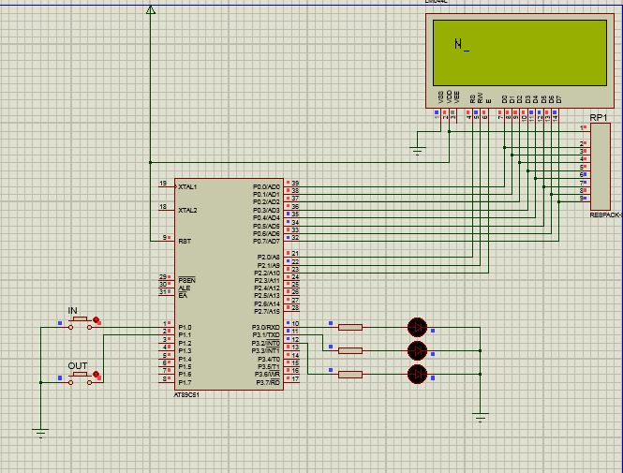
Circuit Diagrams

Slide 7
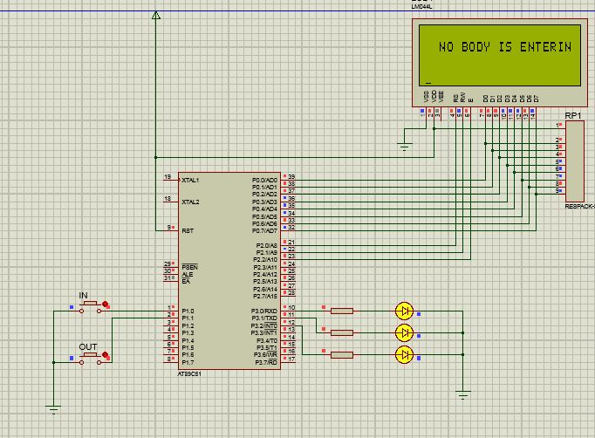

Slide 8
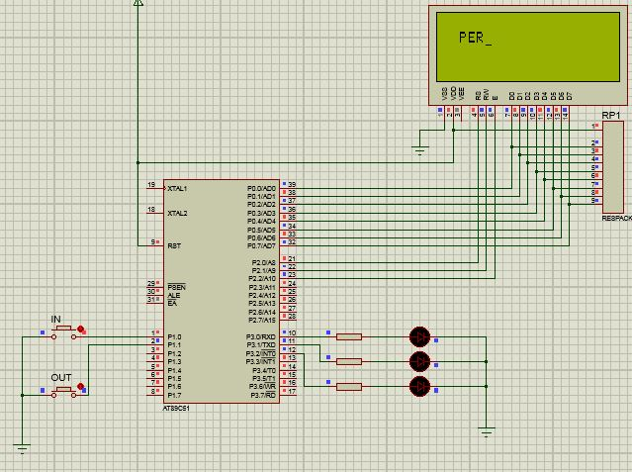

Slide 9
Conclusion
We crated a project “Automatic room lighting system” Using this project we can automatically ON or OFF the lights automatically and even decrease the usage of Electrical energy.

Slide 10
Future Scope
This project can be developed by using IR Sensors.

